Slide 2







A programming language

Slide 3
Topics
Introduction to Python 3
Modules and functions
Strings
Sequences & slicing
Conditional statements
Loop statements
Functions
Object oriented programming
File handling

Slide 4
Topics
Introduction to Python 3
Modules and functions
Strings
Sequences & slicing
Conditional statements
Loop statements
Functions
Object oriented programming
File handling
Overview of language
Installation & getting start
Numbers and math
Variables

Slide 5
Overview of language
More powerful scripting language
Cross platform
Free and open source
High-level , interpreted, interactive and object oriented programming language
Supports of a wide range of application developments from simple text editor to games

Slide 6

Installation and Starting
Installation package resource: https://www.python.org/downloads/
It is available for Windows ,Linux and mac OS
After installing we can start python in three modes,
Immediate mode
Script mode
Integrated Development Environment Mode
Skip >>>
Windows installation >>>
Linux installation >>>

Slide 7
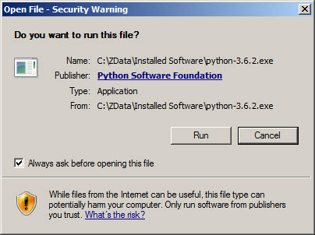
For windows pc
Step 1
Open the downloaded it will ask for security warning and just click on the run button.

Slide 8
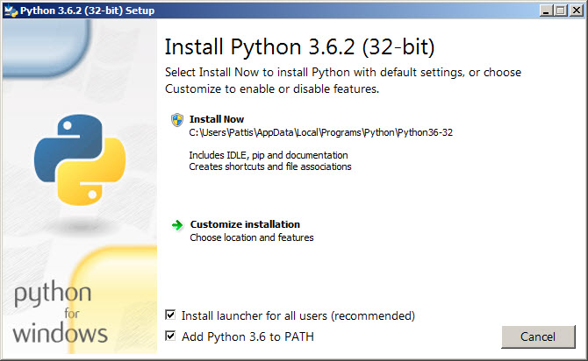
For windows pc
Step 2
After running the file a window will appear like this and made a ✔ on the two boxes below and click on the Install now.

Slide 9
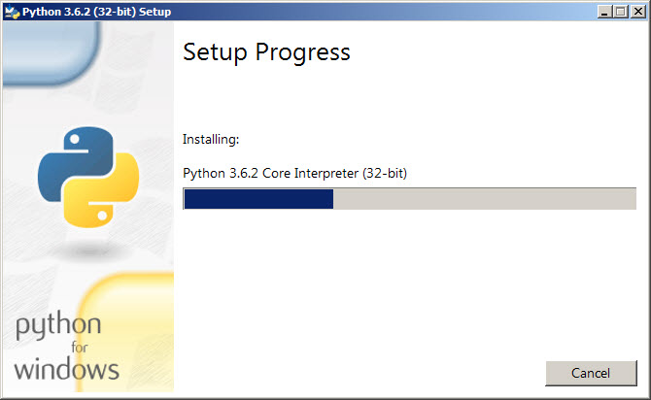
For windows pc
Step 3
Wait until the installation progress get completed

Slide 10
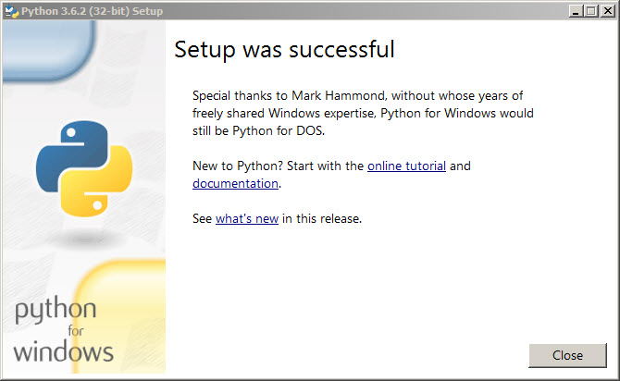
For windows pc
Step 4
Installation successful and click on the close button below.

Slide 11
For Linux pc
Python is pre-installed on major Linux OS
If not found type the following command to install python version 3
Open terminal and type “sudo apt-get install python3” and press Enter
This will ask for password of your user account.(* for security reason the password you being typed will invisible)
Type your password and press enter
You need an active internet connection to fetch software packages
This will download and setting up the python.

Slide 12
Python Keywords
This list shows the python reserved words used as keywords in our programming.
Keywords:
and,assert,break,class,continue,def,deal,elif,else,except,exec,finally,for,from,global,if,import,in,is,lambda,not,or,pass,print,raise,return,try,while,with,yield
These words cannot be used as variables.
All the keywords are lowercase.

Slide 13
Lines and indentation
Line indentations are used to indicate blocks of code for class, functions definitions or flow controls.
Comments
An hash/pound sign(#) is used to represent a line as a comment line

Slide 14
Variables
Variables are the object that have reserved memory locations to store values.
Every variables in Python are treated as objects.
We don’t need to declare variables before using them, or declare their datatype.
Assigning values can be done on more than one variable "simultaneously“

Slide 15
We can use type() function to identify the class of variable and value.
isinstance() function is used to identify whether it is belongs particular class or not.
Combining operators between numbers and strings is not supported.

Slide 16
Rules for Python variables:
A variable name must start with a letter or the underscore character
A variable name cannot start with a number
A variable name can only contain alpha-numeric characters and underscores (A-z, 0-9, and _ )
Variable names are case-sensitive.

Slide 17
Types of datatypes:
Numbers
String
List
Tuple
Dictionary

Slide 18
Numbers and Math
Python supports number datatypes such as integers, floating numbers and complex numbers.
Complex numbers are written in form of x+yj, here x is real and y is imaginary part
Python supports not only math datatypes but also programmer’s math datatypes such as binary ,octal and hexa-decimal by representing them with prefixes.
Number System | Prefix
Binary | '0b' or '0B'
Octal | ‘0o' or '0O'
Hexadecimal | '0x' or '0X'

Slide 19
Python Fractions
Handling fractions in python is done using fractions modules.
We can handle the fraction values in python by importing Fractions from fraction module.
Fraction allows us to instantiate with string as well.
It is the preferred options when using decimal numbers.

Slide 20
Python mathematics
Mathematics like trigonometry, logarithms, probability and statistics, etc. functions are easily implemented using math and random modules.
Math module:
It’s a standard module of python
It doesn’t support complex datatypes
Random module:
Its also a standard module
its is used to implement random functions such as generating random numbers, shuffling numbers etc.

Slide 21
Math module functions
Function | Description
ceil(x) | Returns the smallest integer greater than or equal to x.
copysign(x, y) | Returns x with the sign of y
fabs(x) | Returns the absolute value of x
factorial(x) | Returns the factorial of x
floor(x) | Returns the largest integer less than or equal to x
fmod(x, y) | Returns the remainder when x is divided by y
frexp(x) | Returns the mantissa and exponent of x as the pair (m, e)
fsum(iterable) | Returns an accurate floating point sum of values in the iterable
isfinite(x) | Returns True if x is neither an infinity nor a NaN (Not a Number)
isinf(x) | Returns True if x is a positive or negative infinity
isnan(x) | Returns True if x is a NaN
ldexp(x, i) | Returns x * (2**i)
modf(x) | Returns the fractional and integer parts of x
trunc(x) | Returns the truncated integer value of x
exp(x) | Returns e**x
expm1(x) | Returns e**x - 1

Slide 22
Math module functions
log(x[, base]) | Returns the logarithm of x to the base (defaults to e)
log1p(x) | Returns the natural logarithm of 1+x
log2(x) | Returns the base-2 logarithm of x
log10(x) | Returns the base-10 logarithm of x
pow(x, y) | Returns x raised to the power y
sqrt(x) | Returns the square root of x
acos(x) | Returns the arc cosine of x
asin(x) | Returns the arc sine of x
atan(x) | Returns the arc tangent of x
atan2(y, x) | Returns atan(y / x)
cos(x) | Returns the cosine of x
hypot(x, y) | Returns the Euclidean norm, sqrt(x*x + y*y)

Slide 23
Math module functions
sin(x) | Returns the sine of x
tan(x) | Returns the tangent of x
degrees(x) | Converts angle x from radians to degrees
radians(x) | Converts angle x from degrees to radians
acosh(x) | Returns the inverse hyperbolic cosine of x
asinh(x) | Returns the inverse hyperbolic sine of x
atanh(x) | Returns the inverse hyperbolic tangent of x
cosh(x) | Returns the hyperbolic cosine of x
sinh(x) | Returns the hyperbolic cosine of x
tanh(x) | Returns the hyperbolic tangent of x
erf(x) | Returns the error function at x
erfc(x) | Returns the complementary error function at x
gamma(x) | Returns the Gamma function at x
lgamma(x) | Returns the natural logarithm of the absolute value of the Gamma function at x
pi | Mathematical constant, the ratio of circumference of a circle to it's diameter (3.14159...)
e | mathematical constant e (2.71828...)

Slide 24
String
Strings are identified as a contiguous set of characters in python.
They are represented by quotation marks.
A string a can be sliced using slicing operator ([ ] and [:] )
Indexing is starting from 0 in the beginning of the string and it also allows reverse indexing from -1 in the end.
In python while dealing with strings ,plus (+) sign is the concatenation operator and the asterisk (*) is the repetition operator.

Slide 25
Method | Description
capitalize() | Converts first character to Capital Letter
center() | Pads string with specified character
casefold() | converts to casefolded strings
count() | returns occurrences of substring in string
endswith() | Checks if String Ends with the Specified Suffix
expandtabs() | Replaces Tab character With Spaces
encode() | returns encoded string of given string
find() | Returns the Lowest Index of Substring
format() | formats string into nicer output
index() | Returns Index of Substring
isalnum() | Checks Alphanumeric Character
isalpha() | Checks if All Characters are Alphabets
isdecimal() | Checks Decimal Characters
isdigit() | Checks Digit Characters
isidentifier() | Checks for Valid Identifier
islower() | Checks if all Alphabets in a String are Lowercase
isnumeric() | Checks Numeric Characters
isprintable() | Checks Printable Character
isspace() | Checks Whitespace Characters
istitle() | Checks for Titlecased String
isupper() | returns if all characters are uppercase characters
PYTHON
STRING
FUNCTION
Part 1

Slide 26
join() | Returns a Concatenated String
ljust() | returns left-justified string of given width
rjust() | returns right-justified string of given width
lower() | returns lowercased string
upper() | returns uppercased string
swapcase() | swap uppercase characters to lowercase; vice versa
lstrip() | Removes Leading Characters
rstrip() | Removes Trailing Characters
strip() | Removes Both Leading and Trailing Characters
partition() | Returns a Tuple
maketrans() | returns a translation table
rpartition() | Returns a Tuple
translate() | returns mapped charactered string
replace() | Replaces Substring Inside
rfind() | Returns the Highest Index of Substring
rindex() | Returns Highest Index of Substring
split() | Splits String from Left
rsplit() | Splits String From Right
splitlines() | Splits String at Line Boundaries
startswith() | Checks if String Starts with the Specified String
title() | Returns a Title Cased String
zfill() | Returns a Copy of The String Padded With Zeros
format_map() | Formats the String Using Dictionary
PYTHON
STRING
FUNCTION
Part 2

Slide 27
Lists
It's a python’s compound datatype
It contains the items separated by commas(,) and enclosed by square brackets([ ])
It can be of different datatypes.
Values stored in the list can be accessed using slicing operator.
Indexing the list is starting from 0 in the beginning of the list or from -1 in the end of the list.
Both concatenation operator ,repetition operator can be used with list.
List are mutable, meaning, their elements can be changed

Slide 28
Changing or adding values to the list
Using assignment operator (=) we can change an item or a range of items.
We can add new item using append() function with list or add another list using extend()

Slide 29
Python list functions
Function | Description
append() | Add an element to the end of the list
extend() | Add all elements of a list to the another list
insert() | Insert an item at the defined index
remove() | Removes an item from the list
pop() | Removes and returns an element at the given index
clear() | Removes all items from the list
index() | Returns the index of the first matched item
count() | Returns the count of number of items passed as an argument
sort() | Sort items in a list in ascending order
reverse() | Reverse the order of items in the list
copy() | Returns a shallow copy of the list

Slide 30
TUPLE
It's an another sequential datatype similar to list.
It's enclosed within parenthesis ( )
Values can't be updated.

Slide 31
Dictionary
Dictionary is a collection which is unordered, changeable and indexed.
They have keys and values.
It's enclosed within curly brackets ({ })
It can be created in two method using the curly brackets and using dictionary constructor method ( dict() ).
del() function is used to delete the dictionary.
len() function is used to get the size of the dictionary.

